Slide 1
T1A2
Coder Academy Portfolio Assignment
Raphael Florea

Slide 2
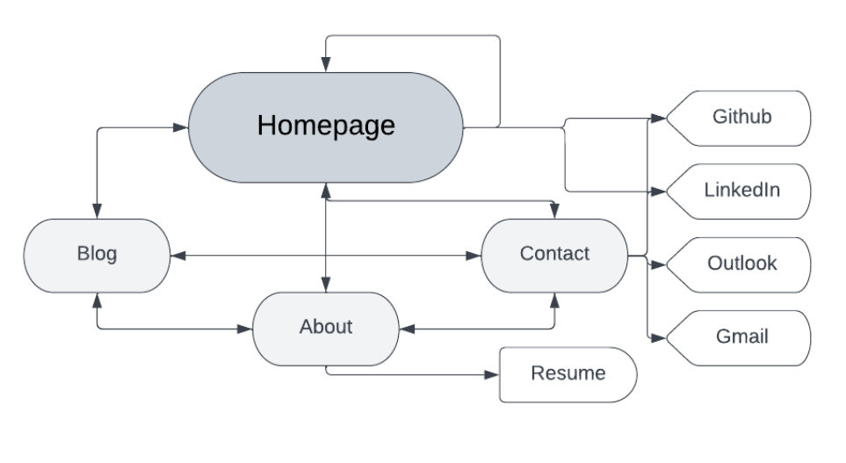
Sitemap
(and navigation)
There are also 4 links to different accounts as shown below:
The 4 main pages are:
Homepage (index)
Blog
About
Contact
The Homepage will feature links in hexagons to the other pages (refer to wireframe in next slide).
The other 3 pages will link to each other using a navbar at the top of those pages.
The About page also has a link to a resume pdf.

Slide 3
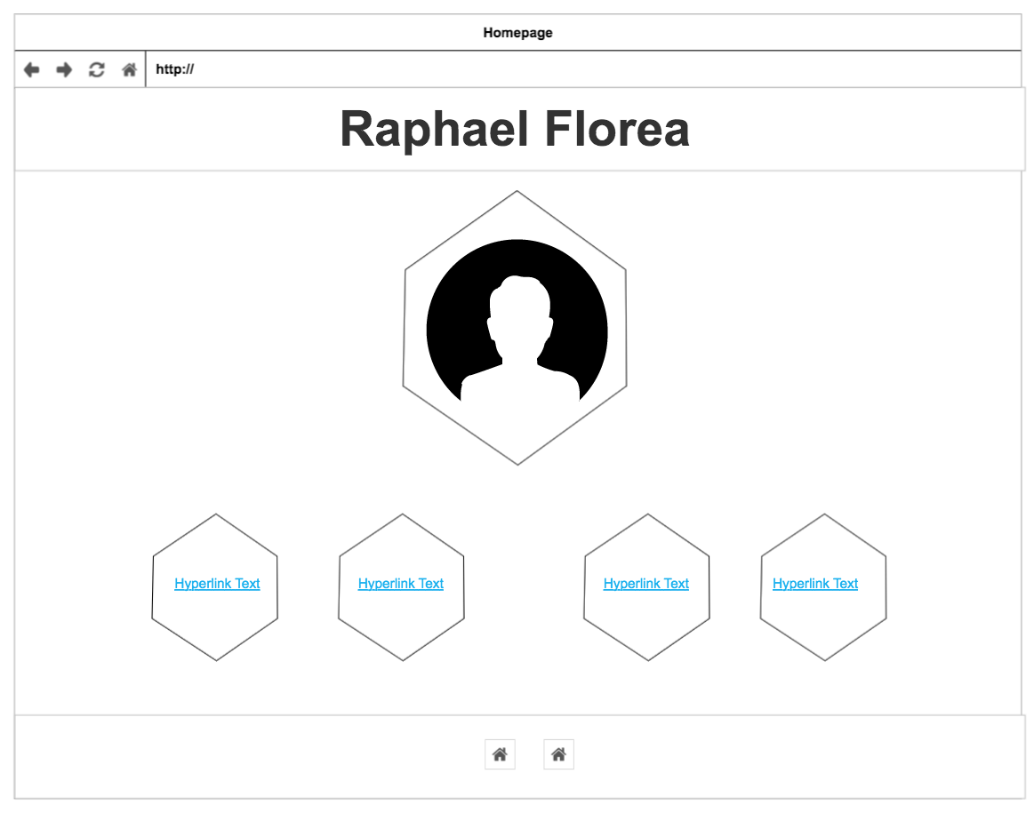
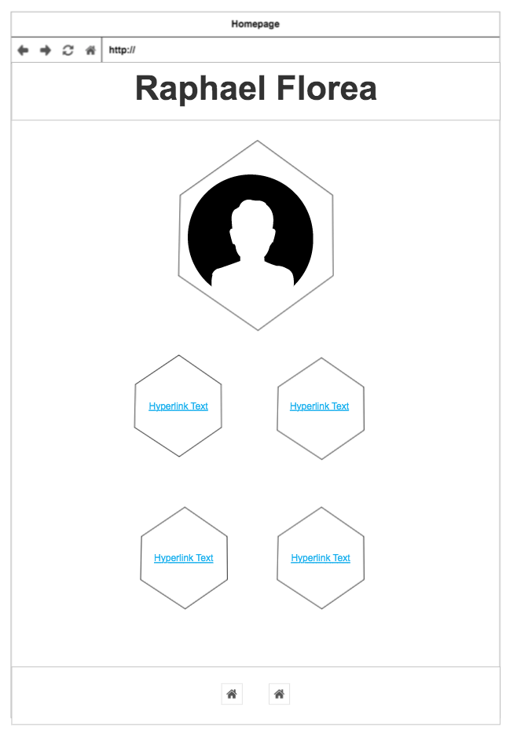
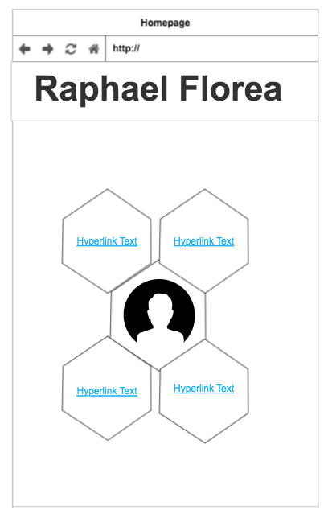
Homepage wireframes for different screen sizes
For desktop, to fill out width of screen, hexagons are now in single row
For tablet, hexagons can afford to have space between them, due to larger screen size
For mobile, hexagons in honeycomb formation to be highly compact
These hexagons provide links to the other pages

Slide 4
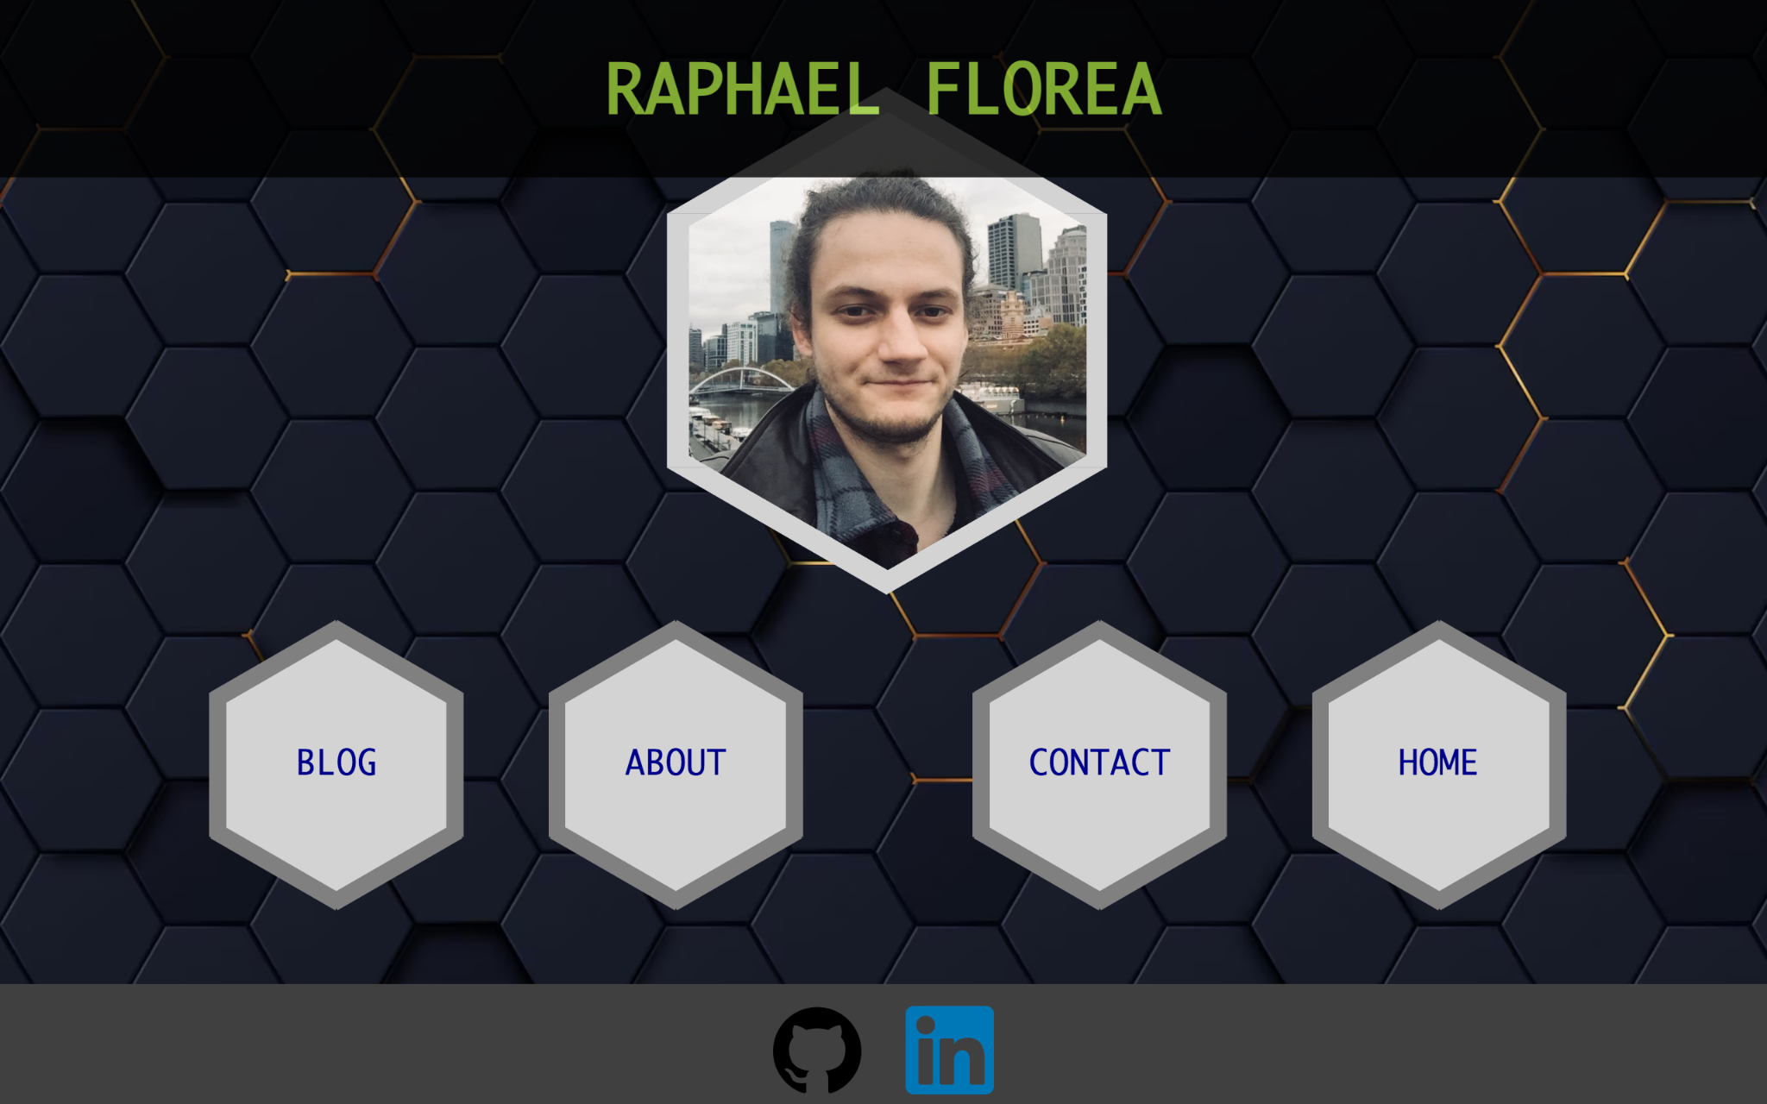
Homepage actual screenshots of desktop size
Main features of page are hexagons on top of honeycomb background.
The profile picture is in a large central hexagon, while links to other pages are in smaller hexagons.

Slide 5
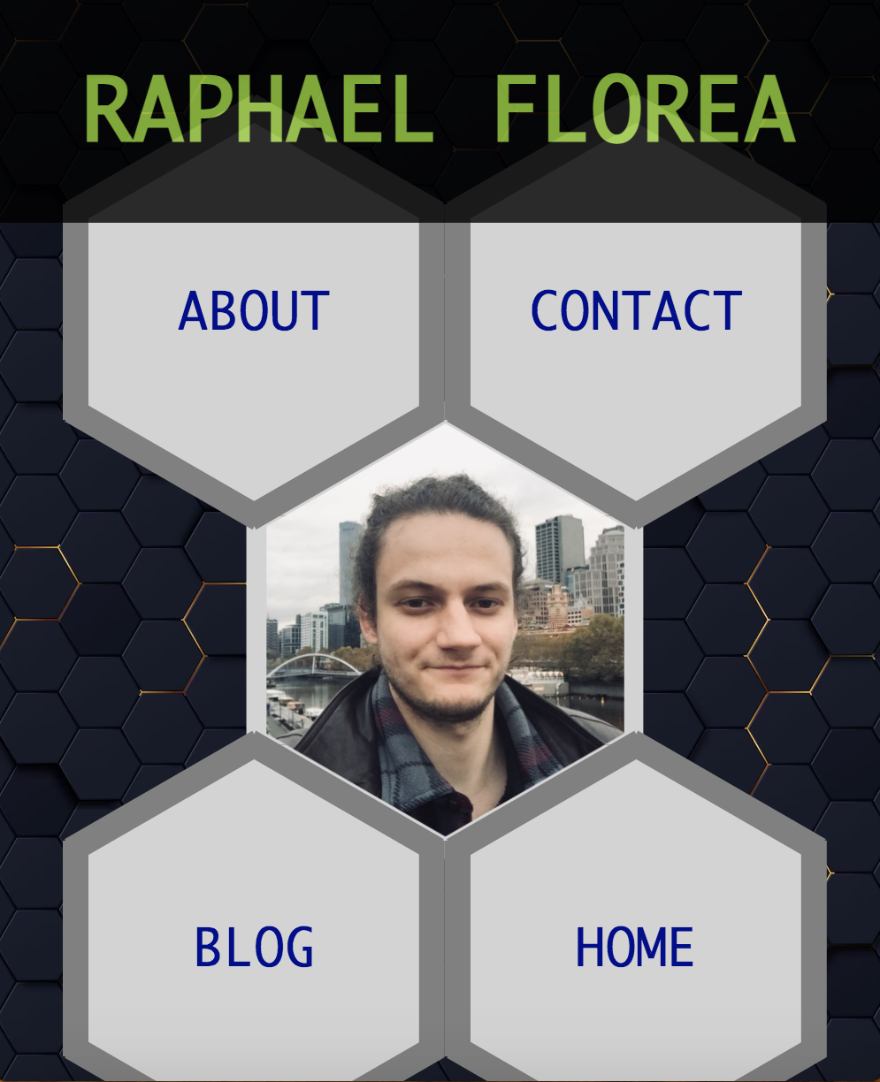
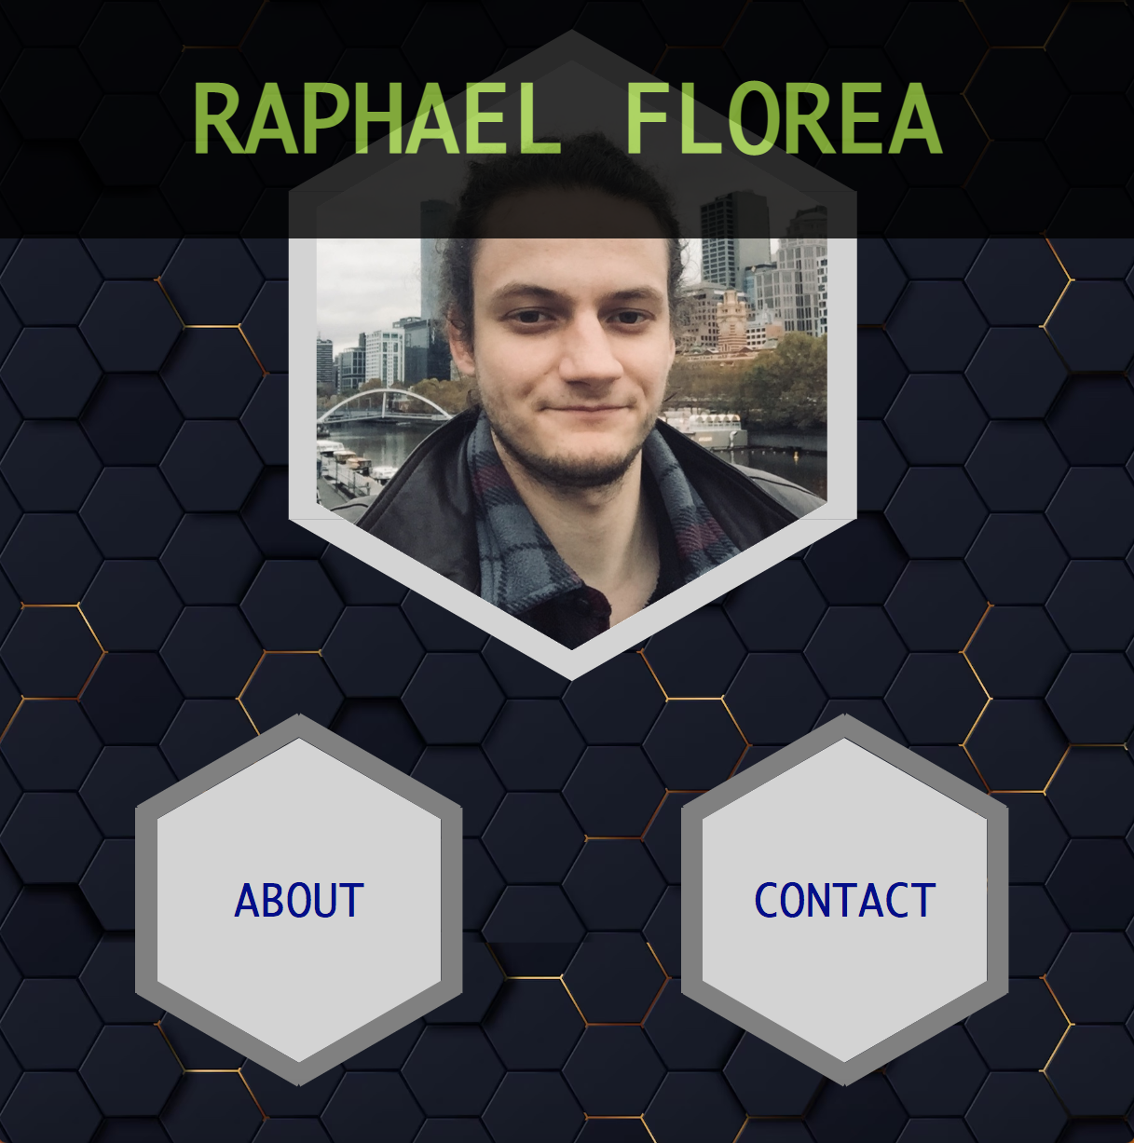
Homepage actual screenshots of mobile and tablet size

Slide 6
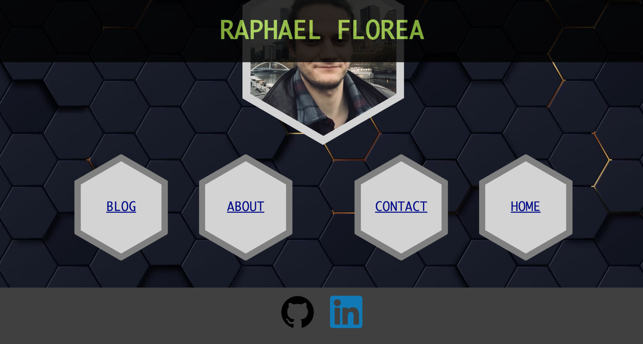

Homepage graphic/text components
Heading of page and footer with professional links
Because the title ‘Raphael Florea’ is set to fixed, it stays on the page even when the user scrolls down.
At the bottom of the page are links to Github and Linked.
These icons are enlarged when hovered over.

Slide 7
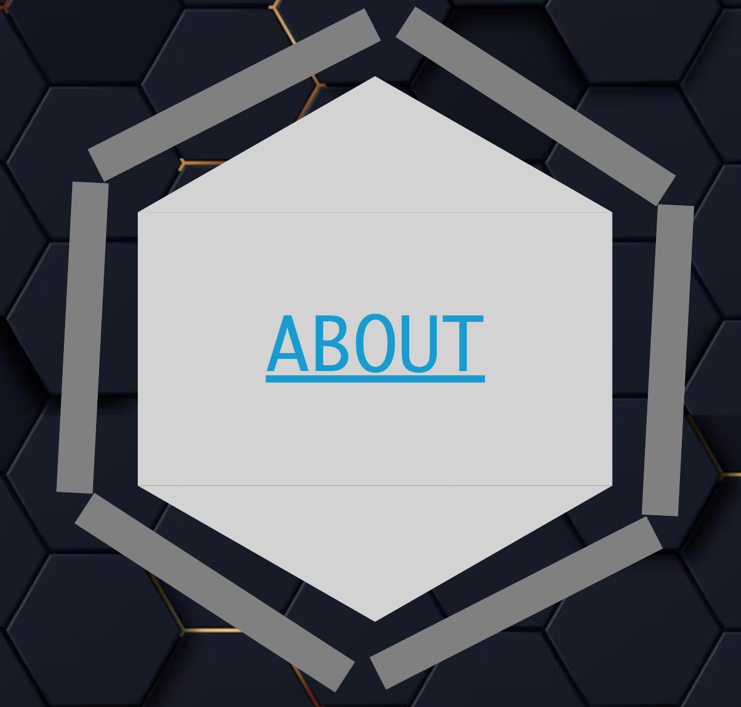
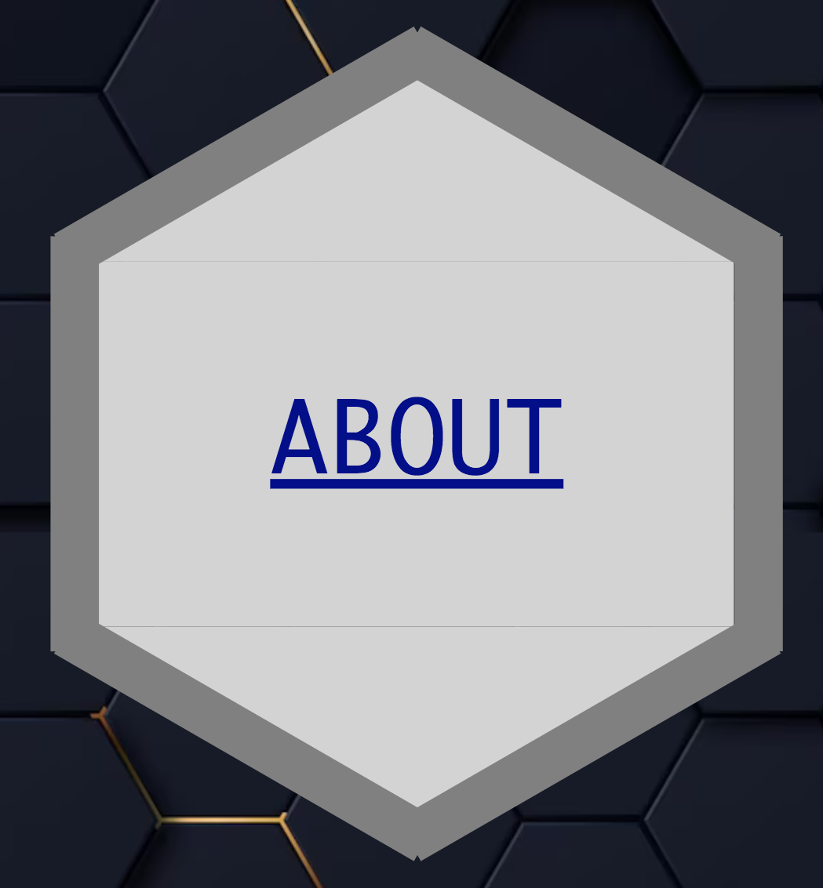
Homepage graphic/text components
Animated hexagons
Additionally, link changes colour.
1
2
1
When link of hexagon is hovered over, rectangles around hexagon radiate around it, while popping inwards and outwards.
2
3
3

Slide 8
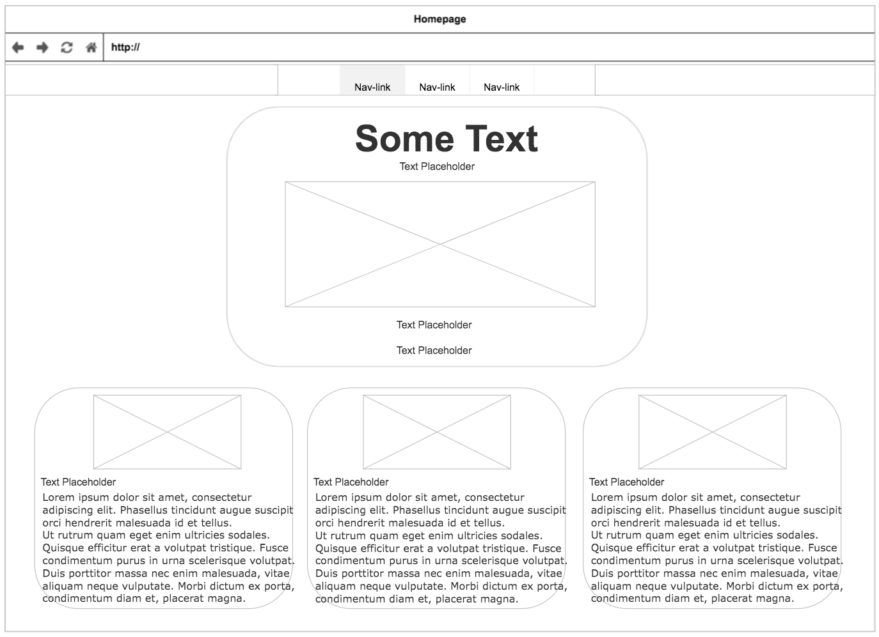
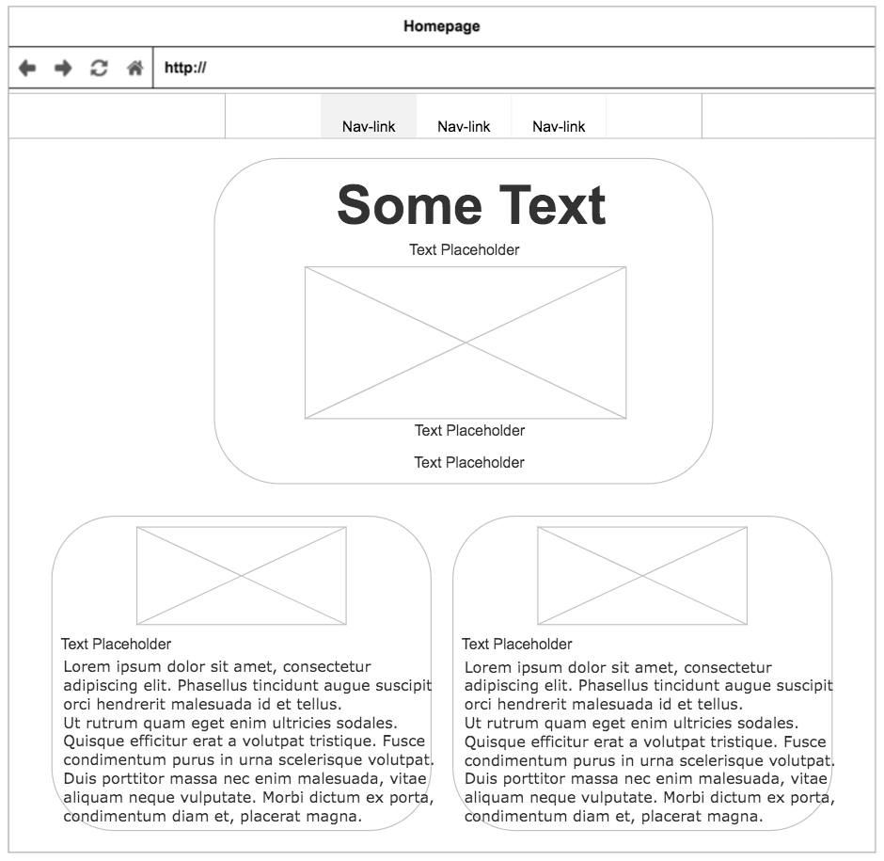
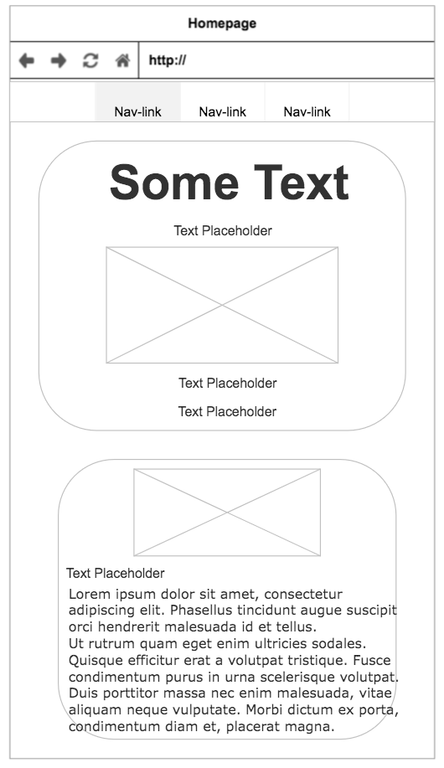
Blog wireframes for different screen sizes
For mobile, there is only 1 row for posts, the central post takes up most of the screen width.
For tablet, there is enough space for 2 columns, the central post takes up proportionally less screen width.
As desktops offers even more space, 3 columns are used here, and the central post takes up the smallest fraction of the screen width.
This is the navbar that will be found on each page (except for the homepage), to link all the other pages together.

Slide 9
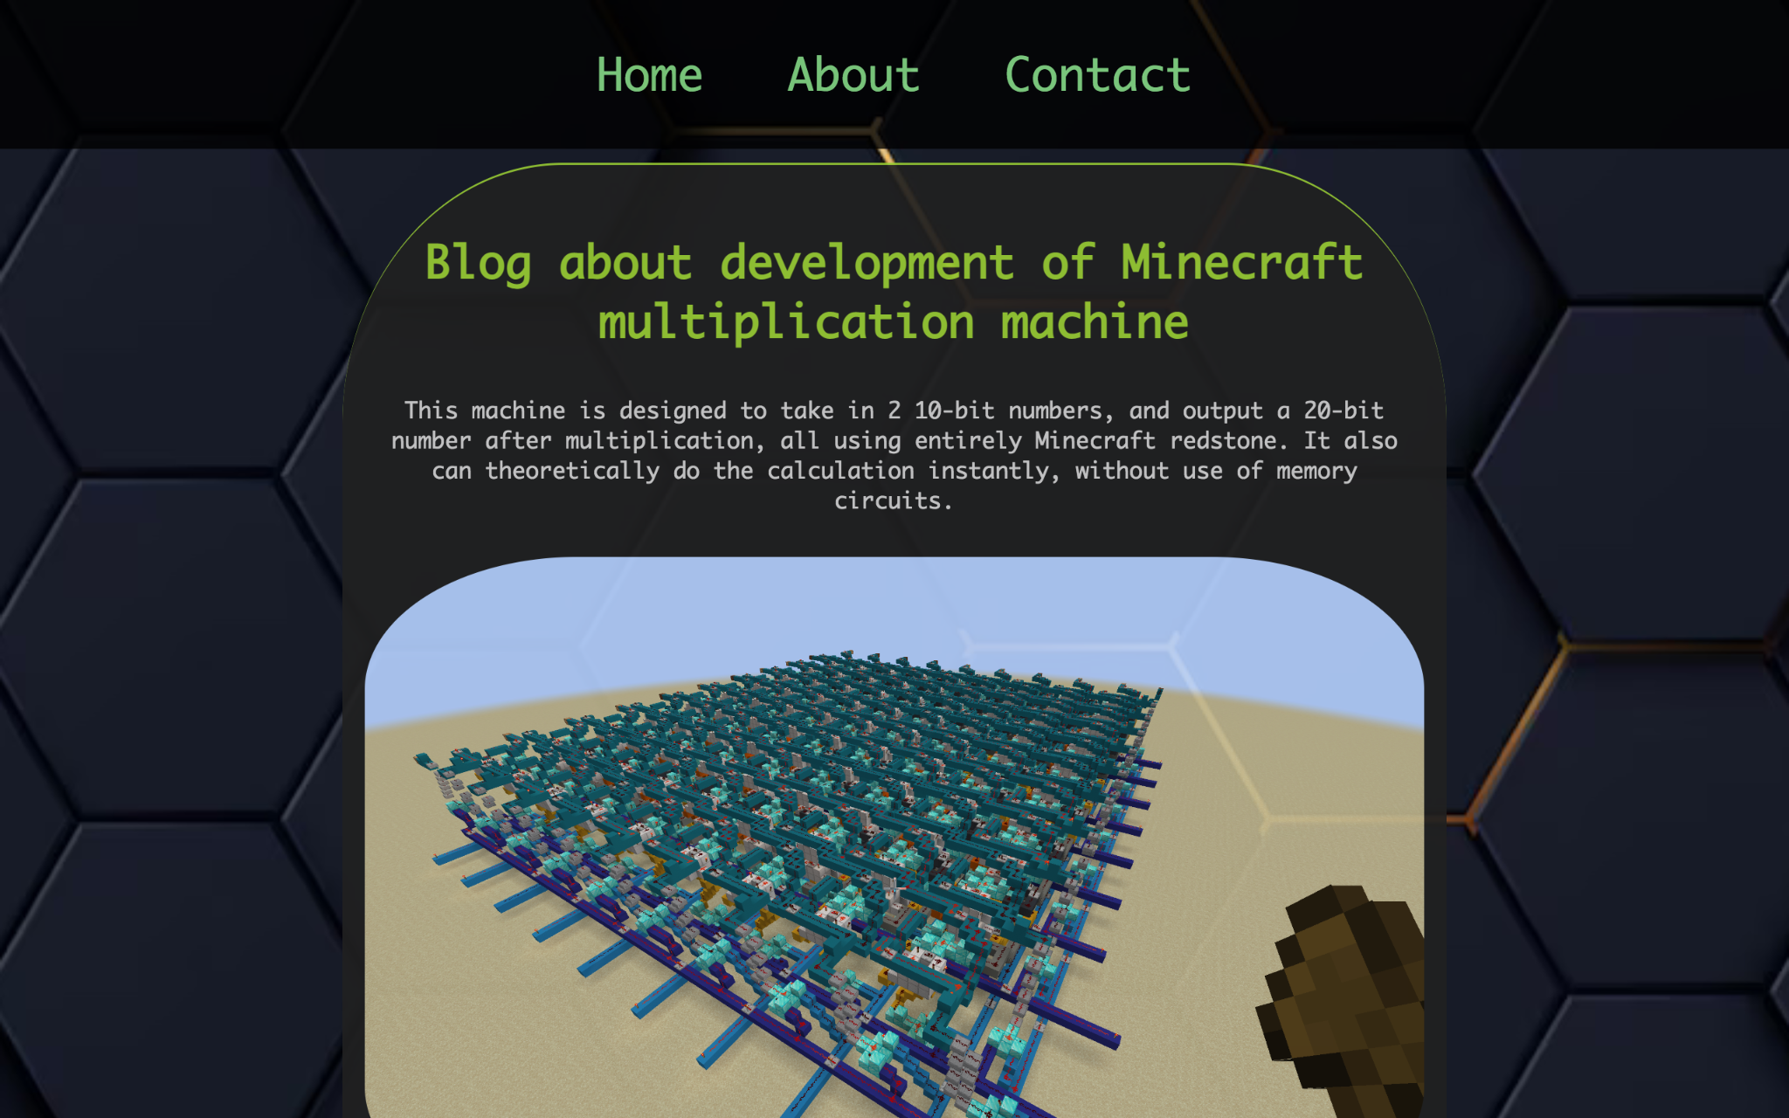
Blog actual screenshot of desktop upper portion
Navbar at top of page to be explained in more detail.
Main title post includes blog summar, a short description, and major image of project.

Slide 10
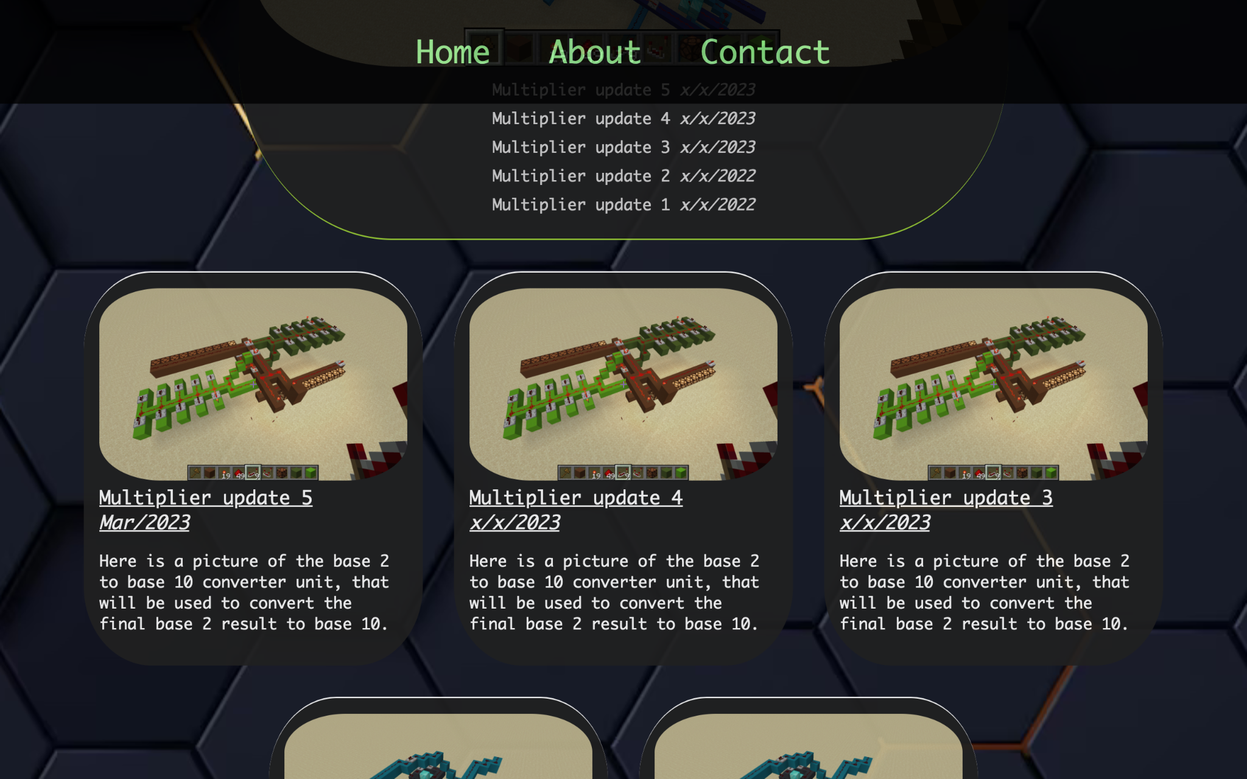
Blog actual screenshot of desktop lower portion
The navbar is set to fixed, so it remains at the top of this webpage.This allows for quick and convenient access to other pages in the site.
Structure of post includes image, post number, date, and description.

Slide 11
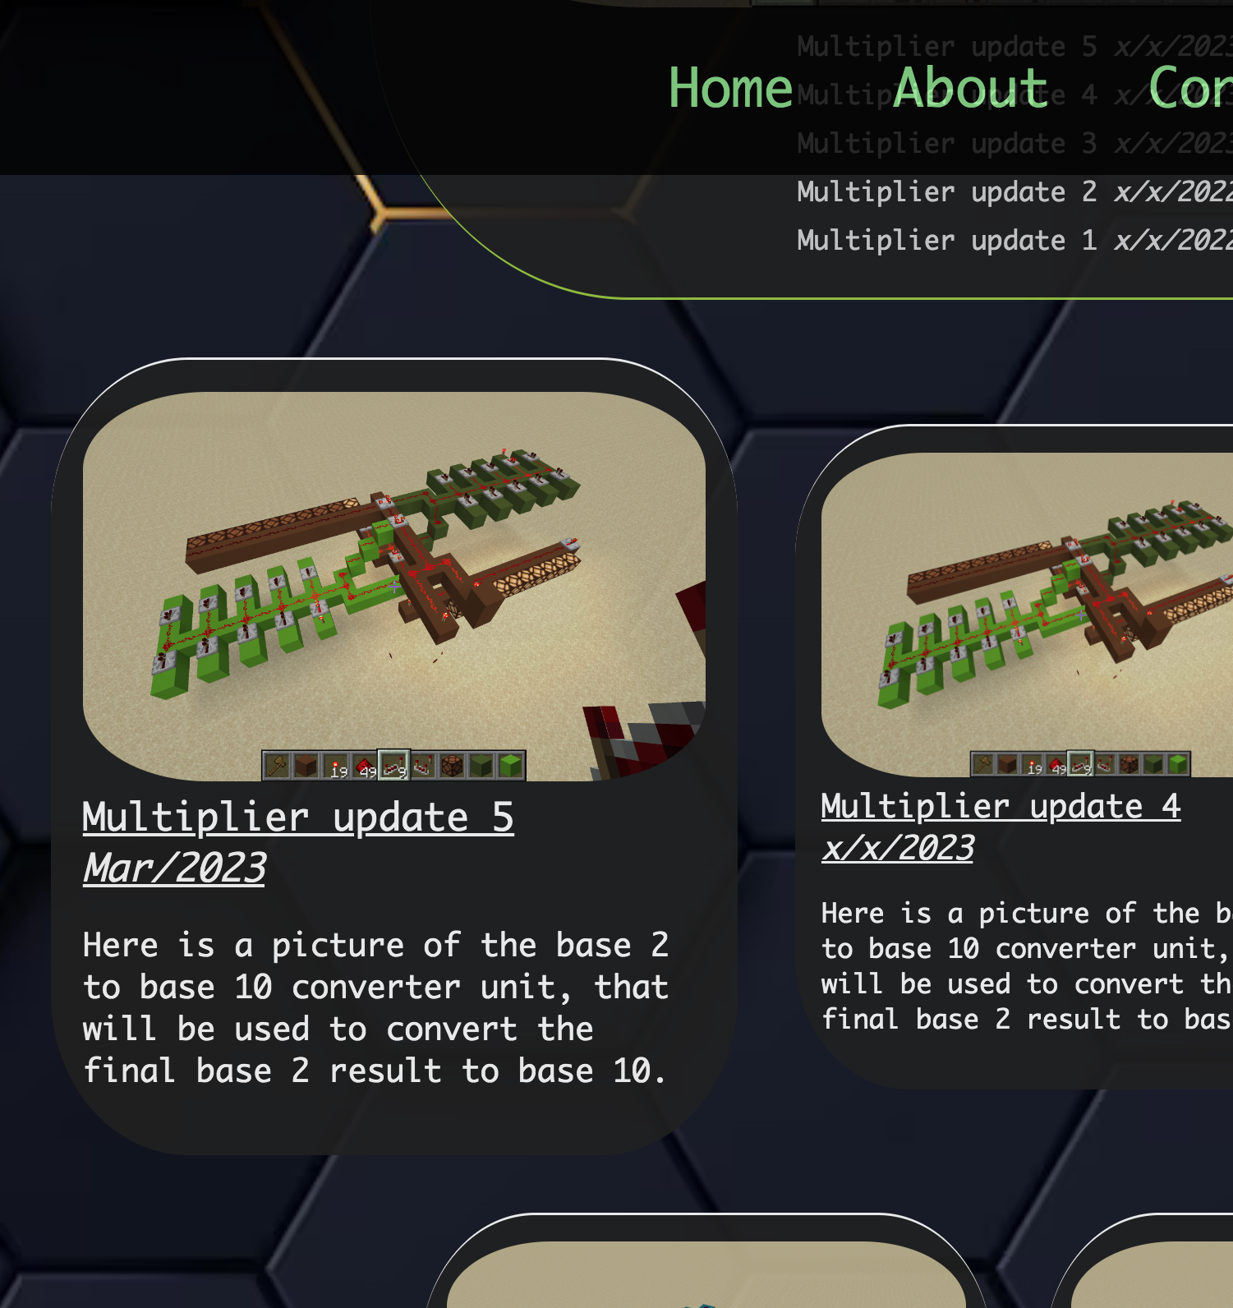
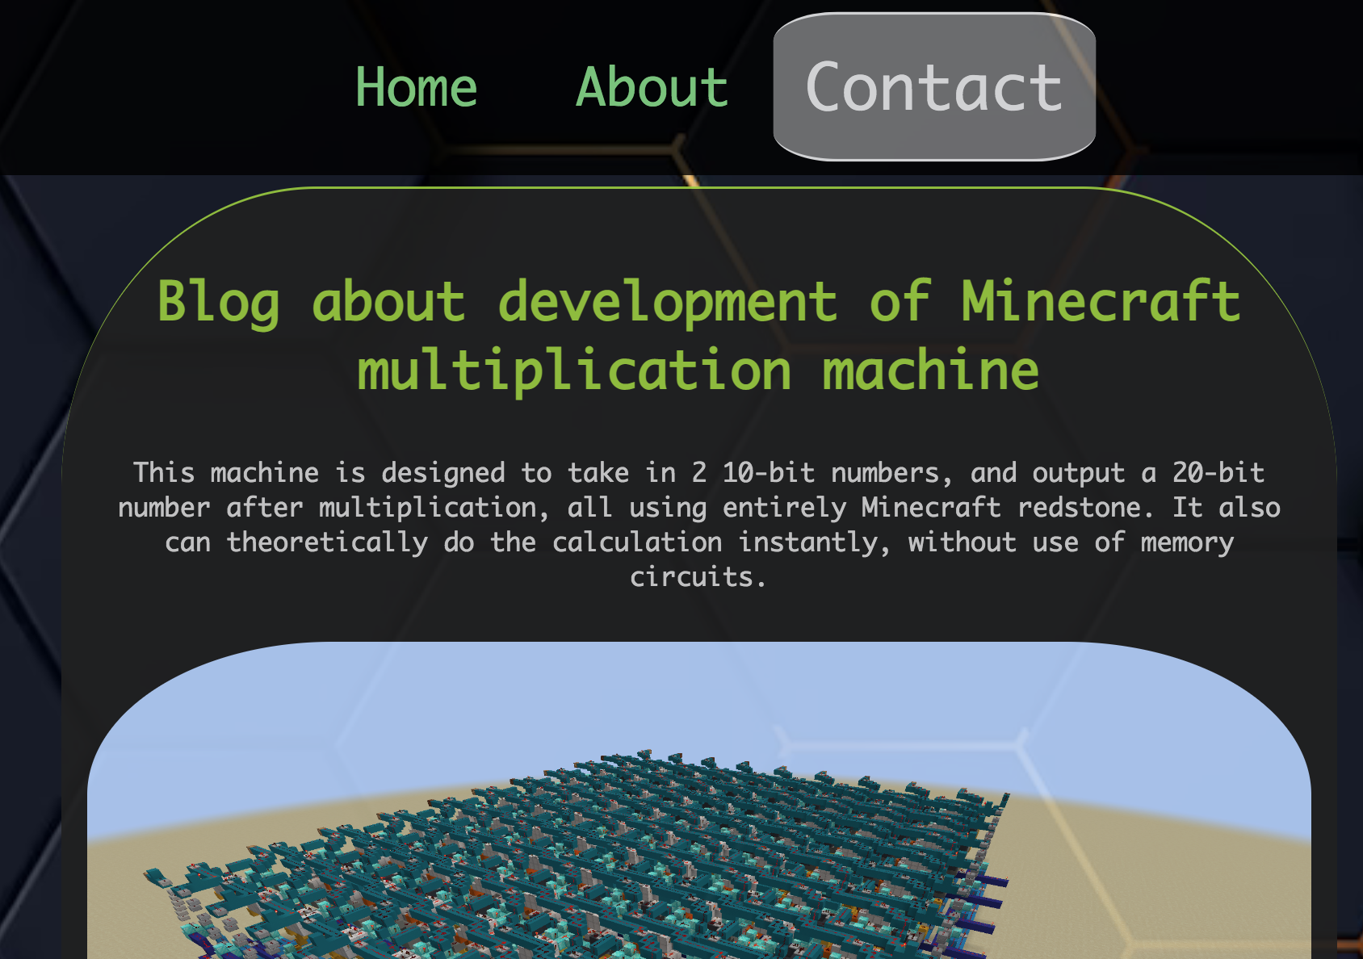
Blog graphical/text components
articles and navbar
When a link is hovered over, it becomes slightly larger, and changes colour while also gaining a background.
This is done in an effort to make the link stand out from the rest of the page, for visual clarity.
When a post is hovered over, it becomes larger, along with the image inside it, as to appear clearer to the viewer.

Slide 12
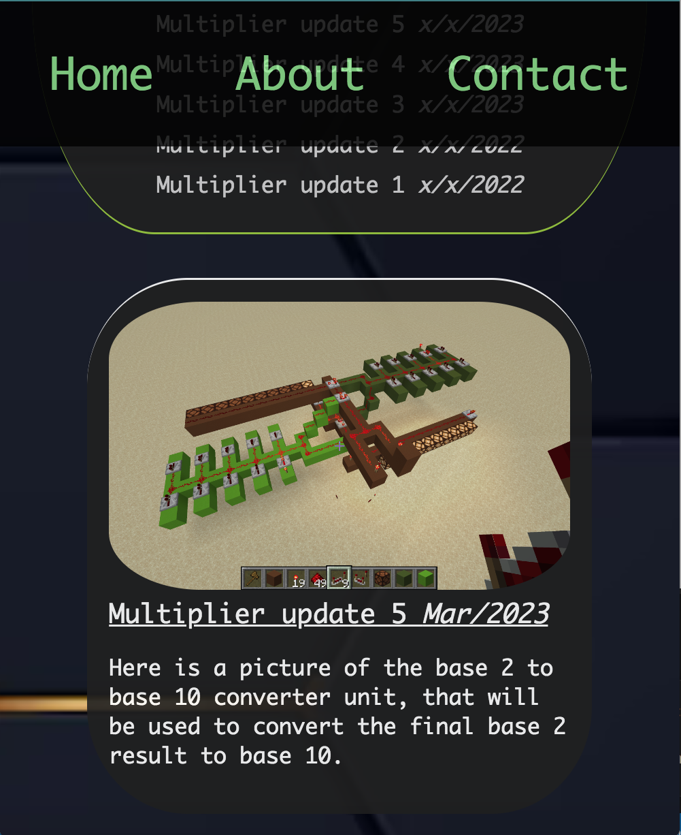
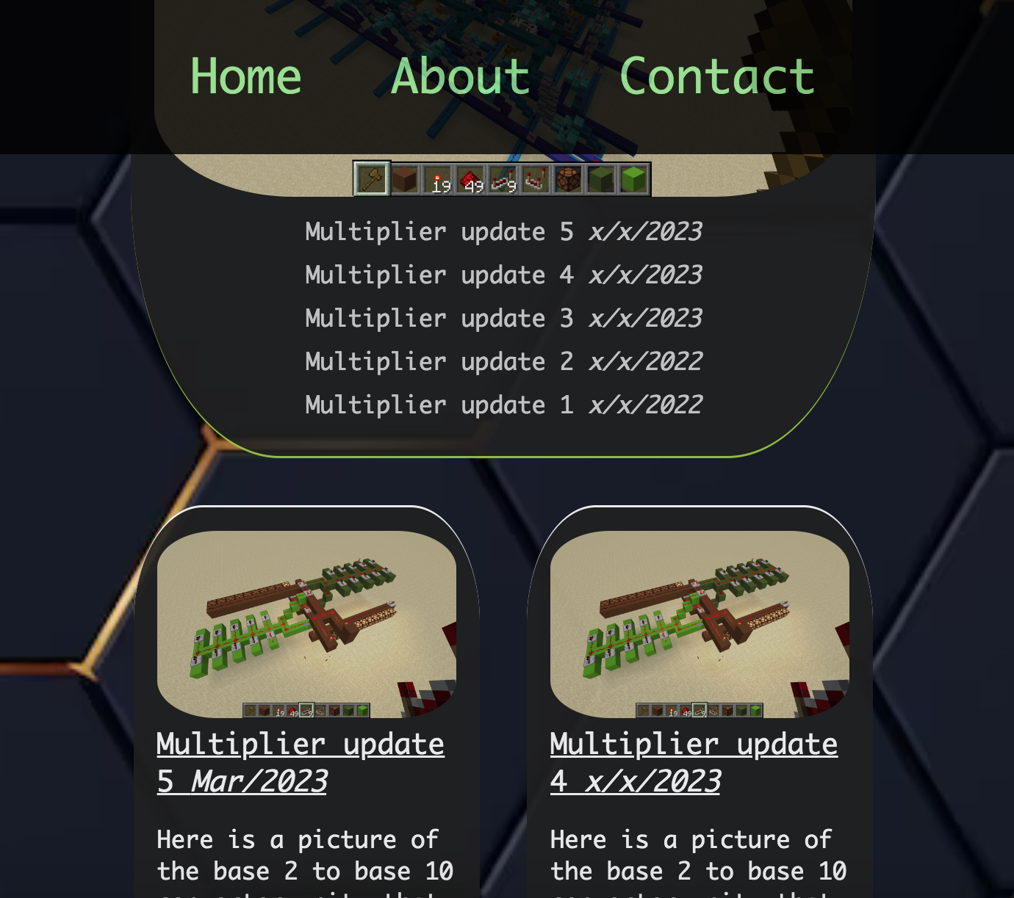
Blog actual screenshots of mobile and tablet size

Slide 13
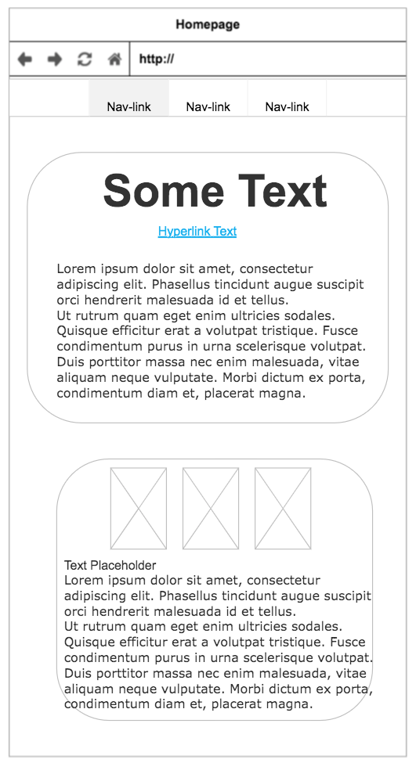
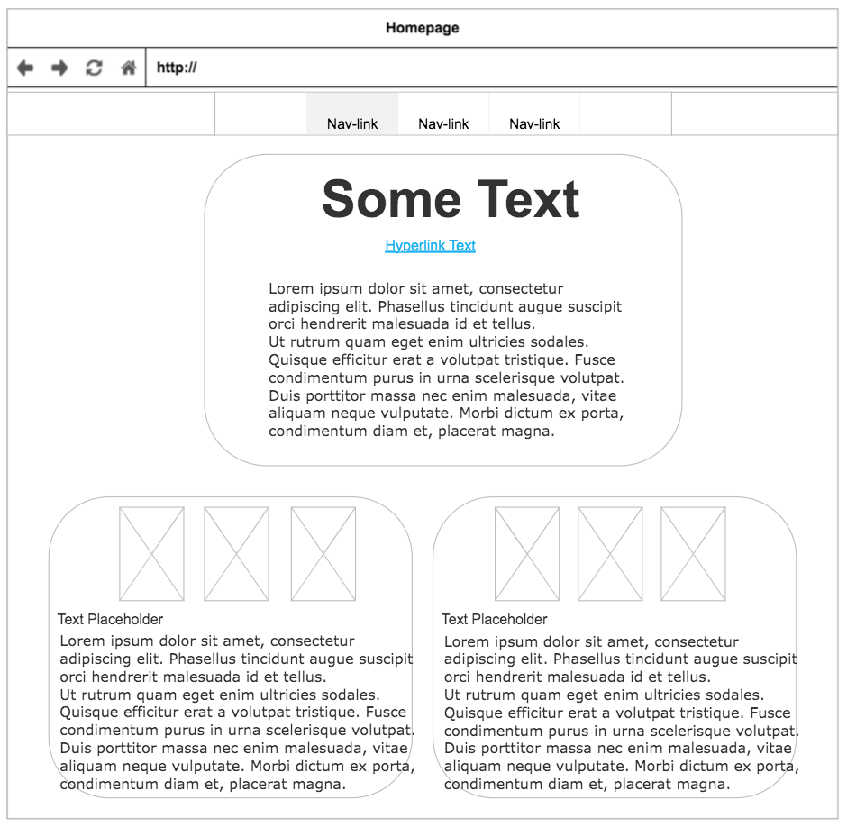
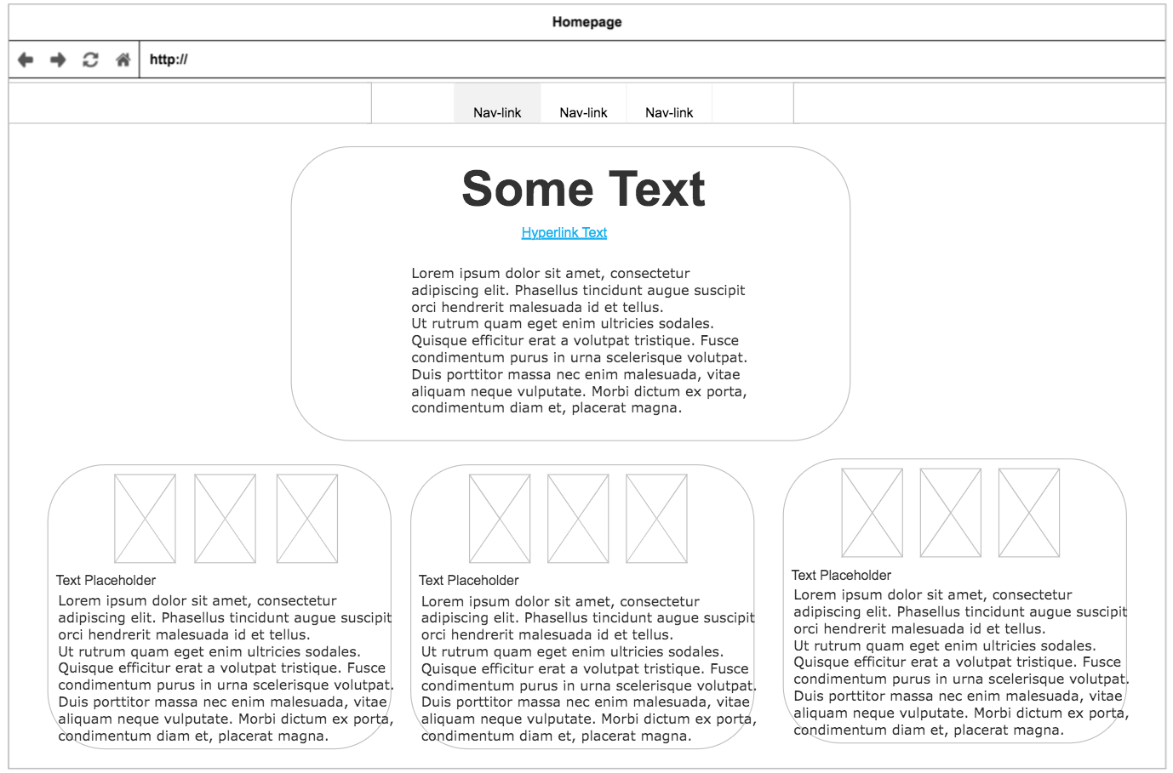
About wireframes for different screen sizes
The stylisation found in the About page is very similar to that of the Blog page:
The number of columns varies between 1, 2, and 3, depending on screen width
The central heading section takes up proportionally less width the bigger the screen size
There is again the same navbar from before

Slide 14
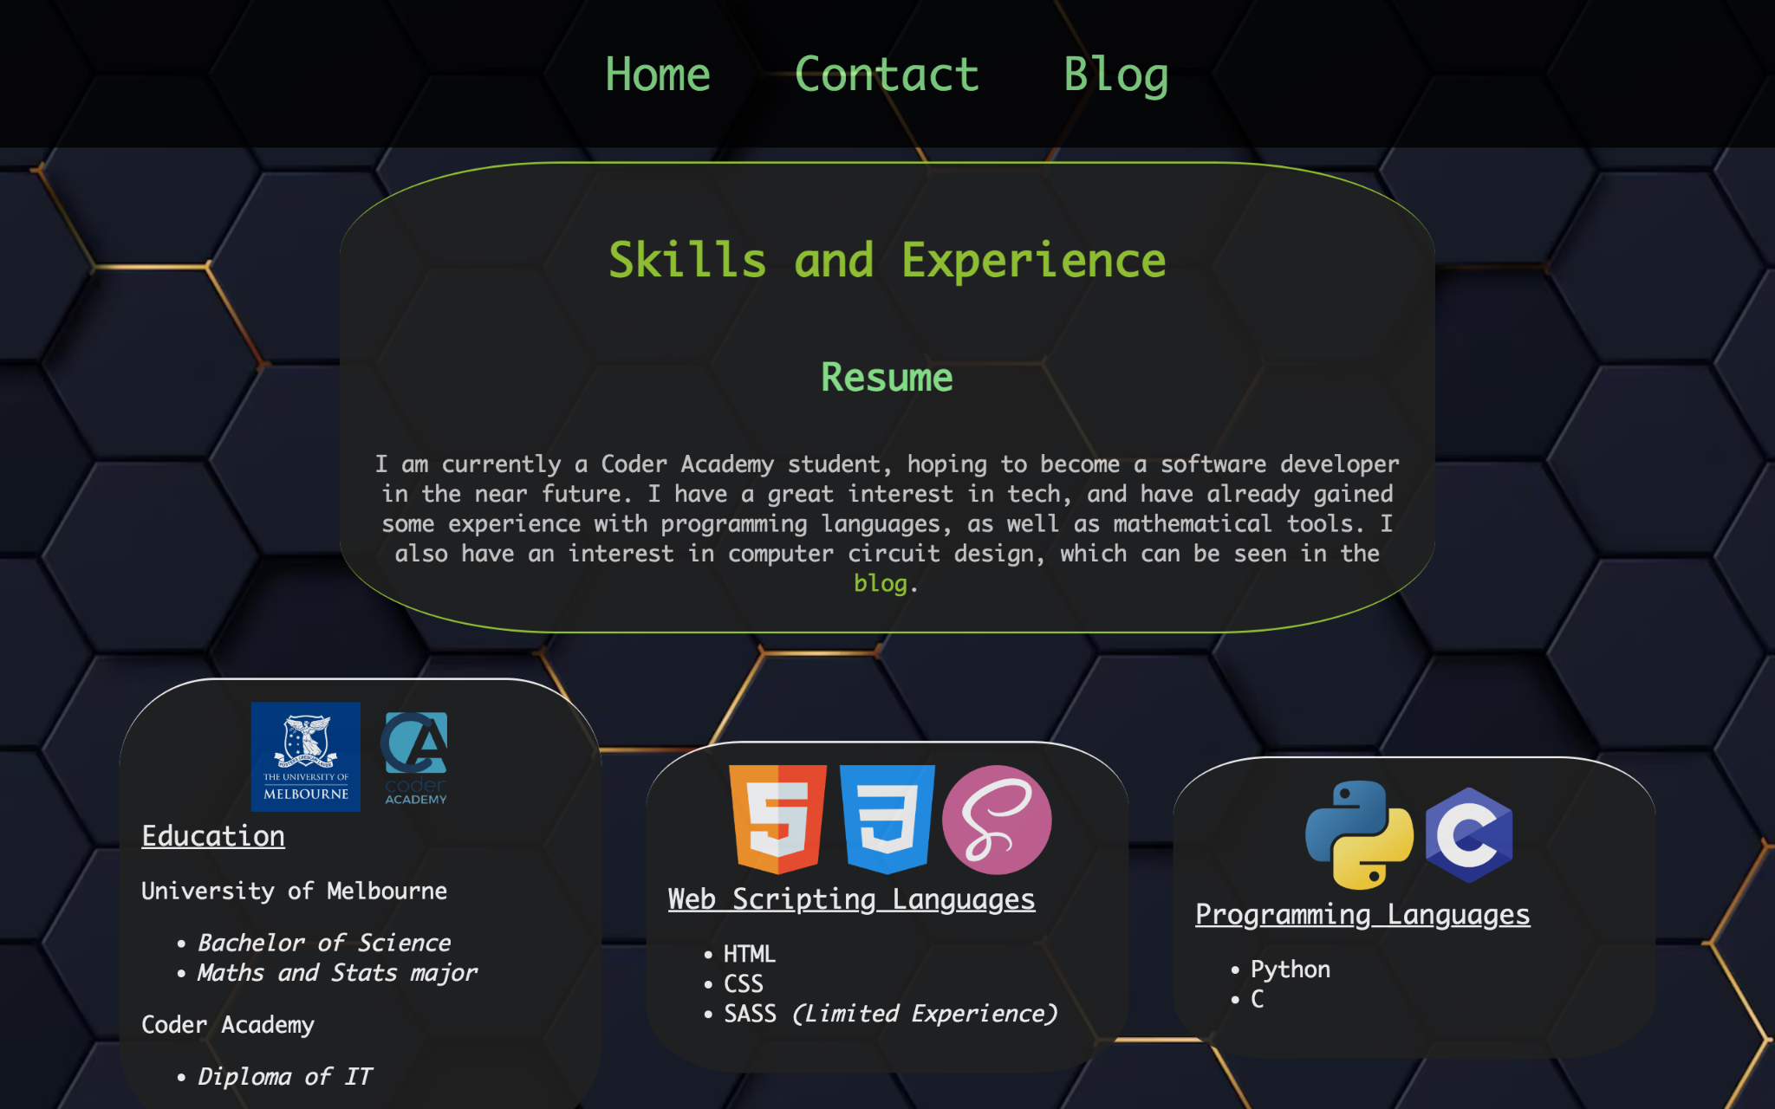
About actual screenshot of desktop size
Navbar returns from the Blog page
Link to resume, enlarges the same way navbar links do.
A second link to blog, for better connectivity.
Articles in the About page function very similarly to the Blog articles, but have icons instead of a single image.

Slide 15
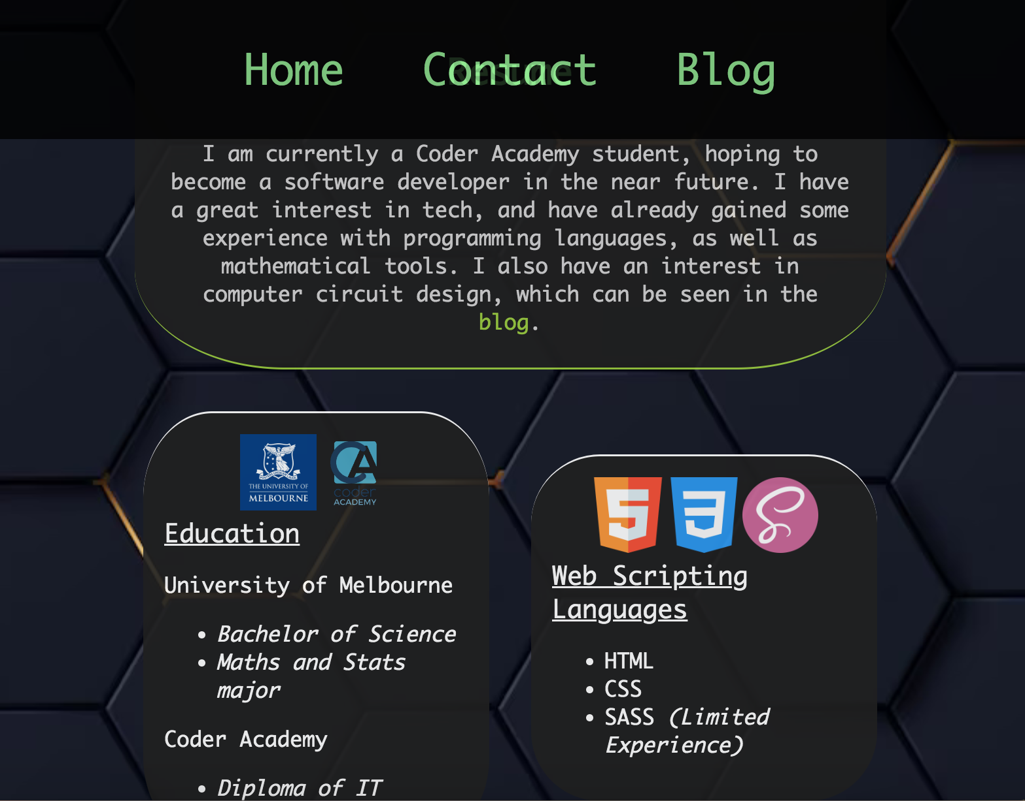
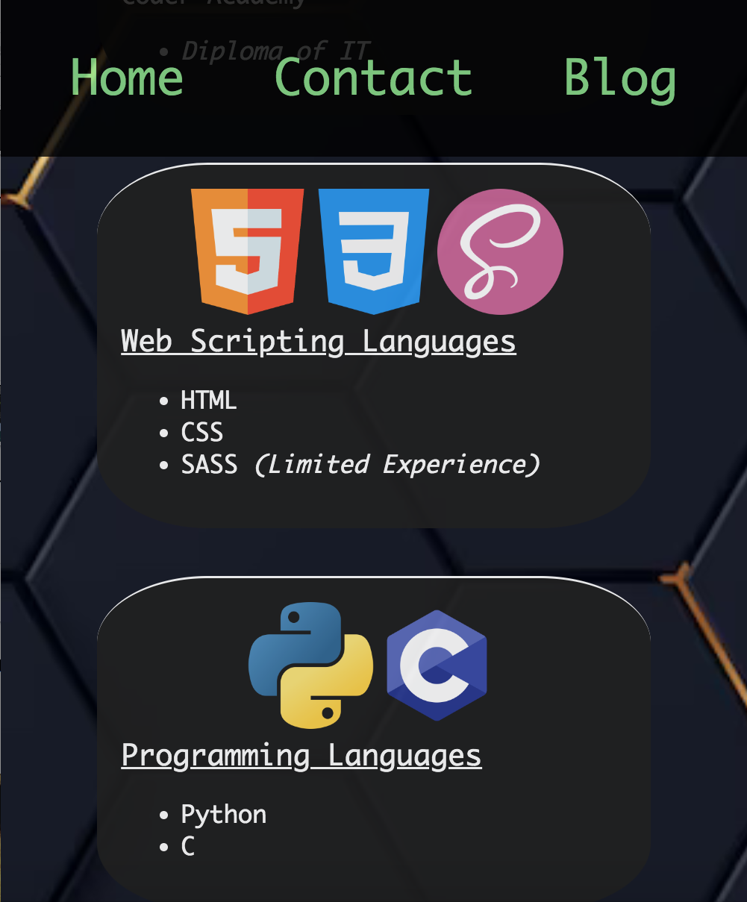
About actual screenshot of mobile and tablet sizes

Slide 16
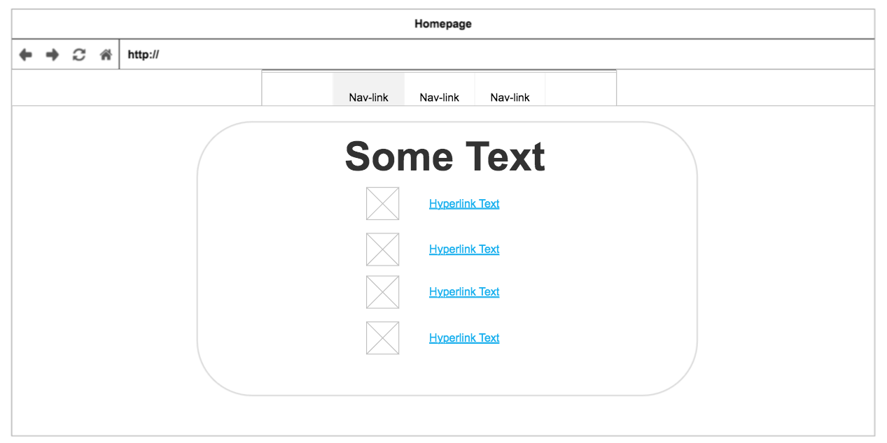
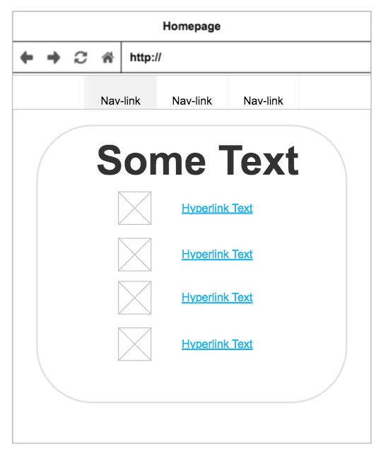
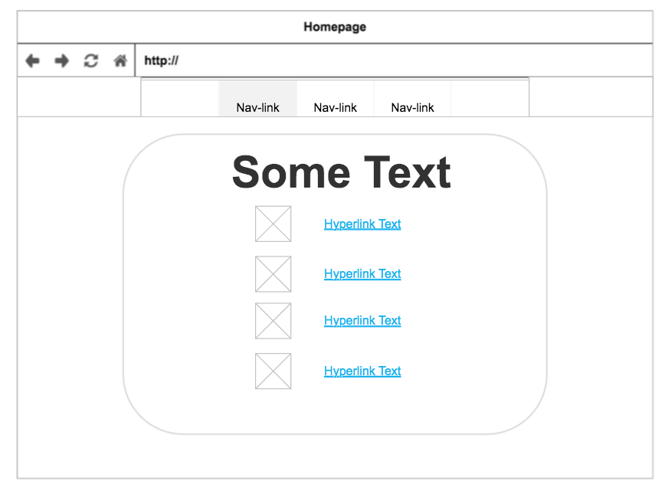
Contact wireframes for different screen sizes
For the Contact page, the displays look mostly the same between the different screen sizes.
The main difference is that the larger the screen size, the less the main section takes up proportionally in terms of width.
Desktop
Mobile
Tablet

Slide 17
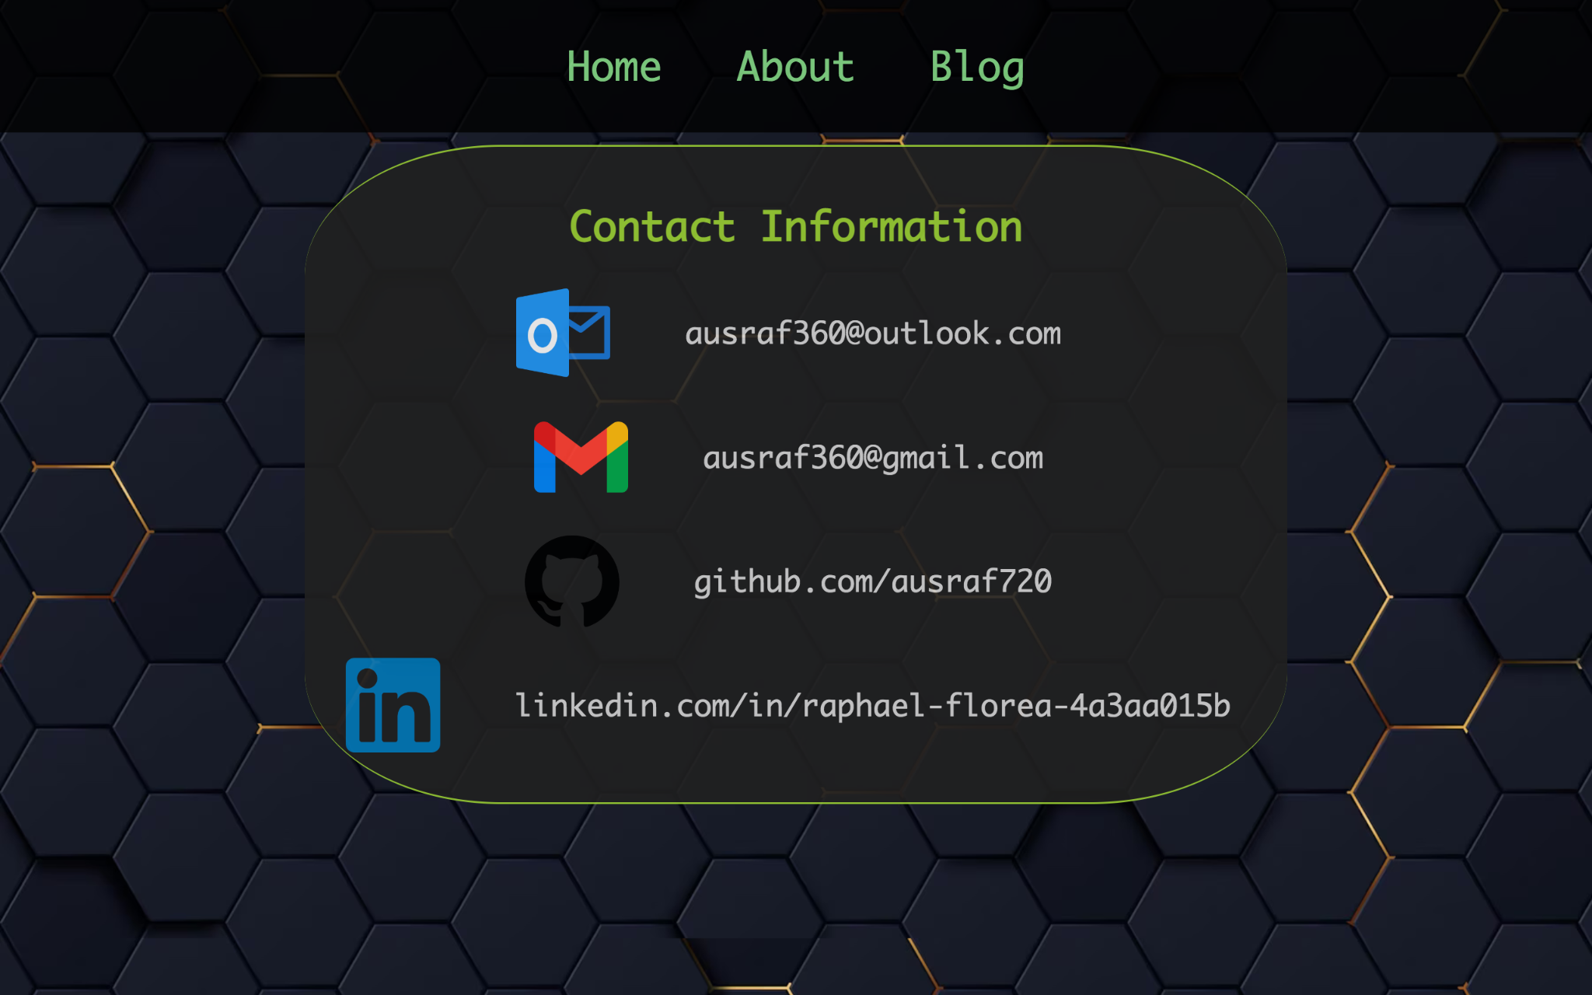
Contact actual screenshot for desktop size
Same navbar as before.
Contact links with an icon next to them for more clarity.

Slide 18
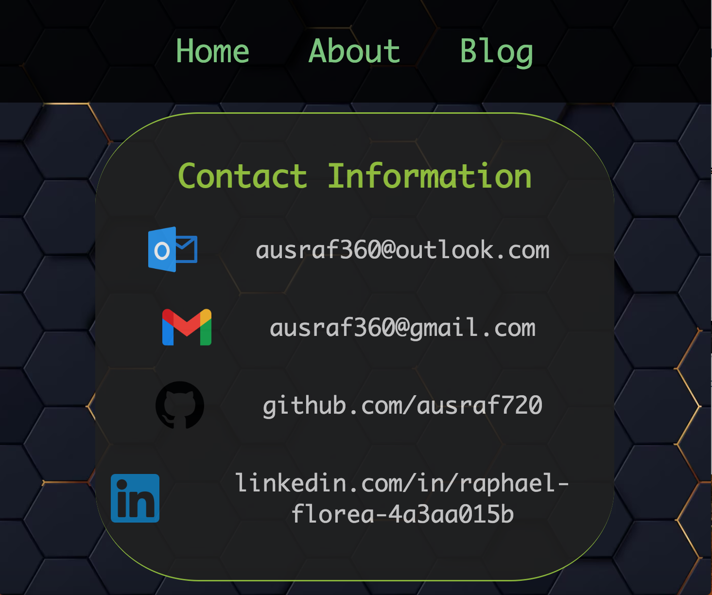
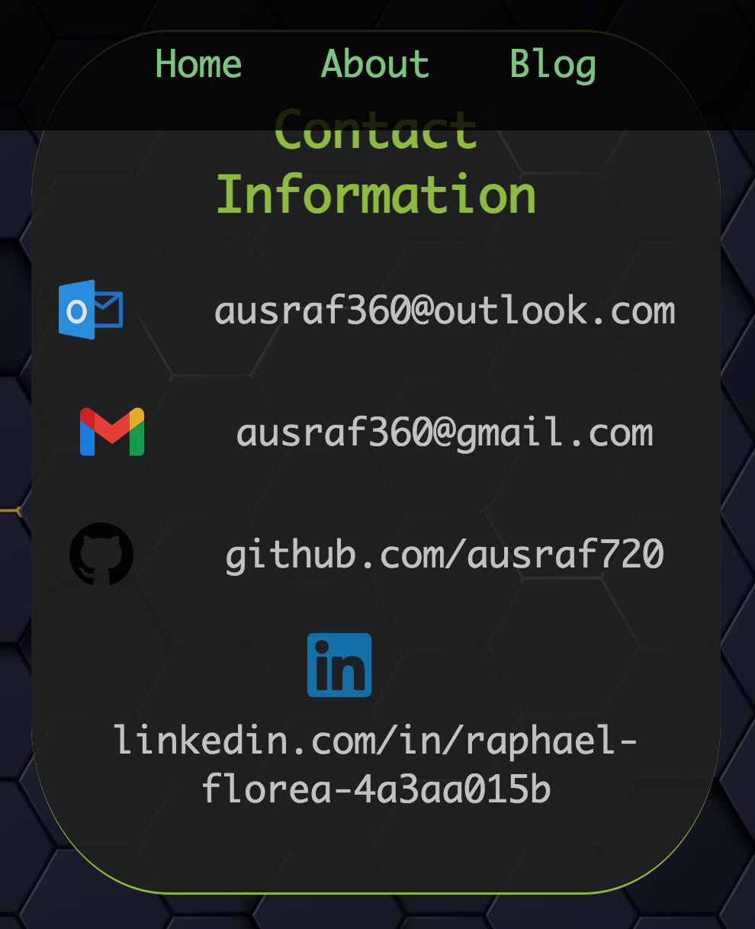
Contact actual screenshot for mobile and tablet sizes
Icons for each contact line usually appear next to contact, but for mobile screens the icon appears on top due to less width available.

Slide 19
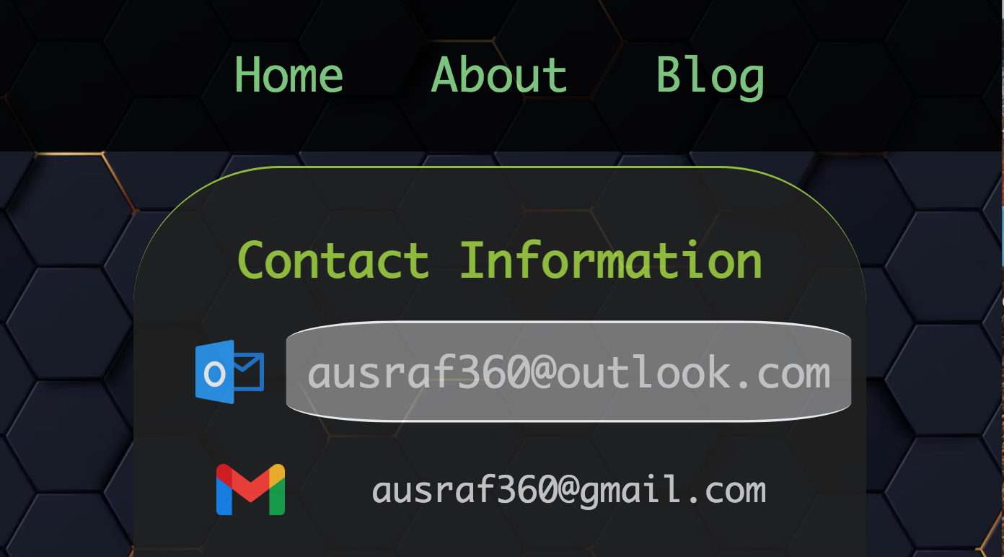
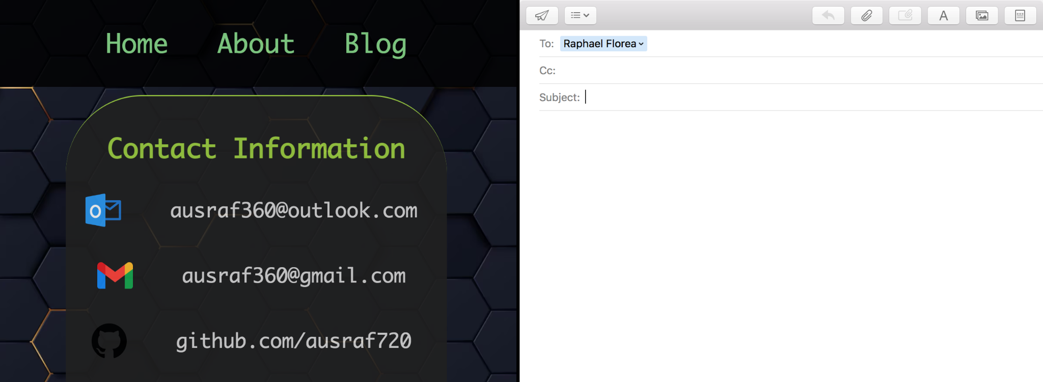
Contact graphical/text components
Hovering over link causes it to be enlarged and change background, similar to navbar links.
Choosing one of the email links also opens up personal email provider, with email draft to that particular address.

Slide 20
T1A2
Thank you for watching

